Slide 1
ONE CITY. ONE MISSION.

Slide 2
Chicago’s Challenges
Despite decades of community initiatives, prayer and giving, Chicago continues to face challenges of:
Unprecedented levels of violence and homicides
Poverty, unemployment, and lack of economic opportunity
Broken family structure
An underperforming public education system
Deteriorating levels of trust between the police force and civilians
Historically low levels of successful prosecutions for homicides and other serious crimes
Hopelessness and despair

Slide 3
Isolated IMPACT
VS
Collective IMPACT
Isolated Impact
Collective Impact
Funders select individual grantees that offer the most promising solutions
Nonprofits work separately and compete to produce the greatest independent impact
Evaluation attempts to isolate particular organization’s impact
Corporate and government sectors are often disconnected from the efforts of foundations and nonprofits
Funders and implementers understand that social problems and their solutions arise from the interaction of many organizations within a larger system
Progress depends on working toward the same goal and measuring the same things
Large scale impact depends on increasing cross-sector alignment and learning among organizations
Corporate and government sectors are essential partners
Organizations actively coordinate their actions and share lessons learned.

Slide 4
Collective Impact
Collective Impact
Common Agenda
Backbone Support Organization
Shared Measurement
Continuous Communication
Mutually Reinforcing Activities

Slide 5
Together Chicago’s Guiding Principles
Focus on starting in a few specific neighborhoods and expand over time
Don’t replicate services that others are providing but help to add value with resources and energy to the most successful existing programs and initiatives
Leverage existing programs of the City of Chicago and other key government and municipal organizations such as Opportunity Zones
Leverage events already underway such as the Obama Library initiative
Expand the reach and impact of the faith based community in every way possible

Slide 6
Elements Connected by Together Chicago
Churches
Non Profit Organizations
Businesses
City, County and State Government
Public and Private Schools

Slide 7
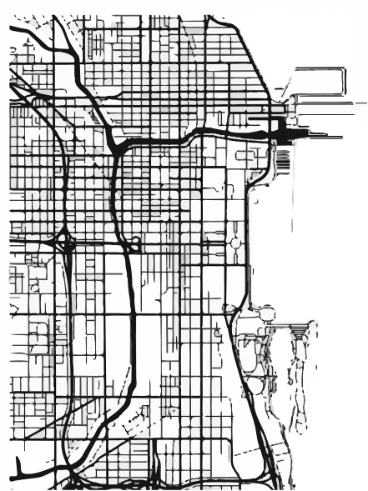
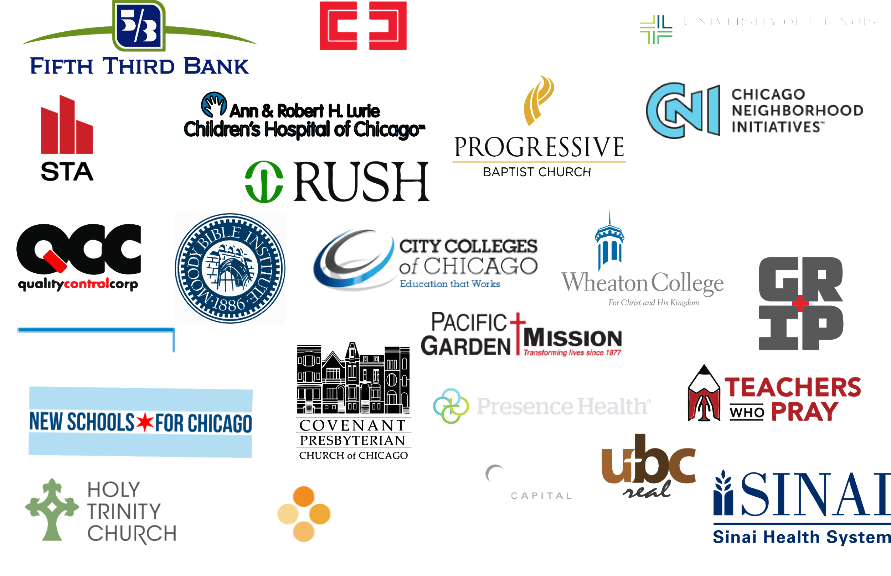
Our Partners

Slide 8
Together Chicago believes that, in order to facilitate meaningful and lasting change, the key sectors of our society including the faith and the business communities must be brought together to re-imagine ways of working together
We are working on specific opportunities in these areas:
Economic Development
Education
Enhancement
Violence
Reduction
Gospel
Justice

Slide 9
Healthcare Opportunity
~ 6,000 Annual Hires
43,800 Employees
~$5.4 B in Employee Spending Potential
$4 B in Salaries/Wages
$ 2.8 B in Supply Chain/ Service Expenses
89,117 Annual admissions

Slide 10
Job Creation Pipeline
candidates receive degree and/or trade certificates
Community Talent Pool
Faith-based Talent Pool
Higher Learning
candidates gain:
- soft skills
- life coaches
In Chicago, thousands of people remain unemployed because of systemic and personal challenges that prohibit them from reaching their full potential. “A good job stops a bullet.”
candidates fill vacancies in labor deprived industries
Workforce development
Healthcare
Technology
Advanced Manufacturing

Slide 11
Opportunity
There is an opportunity for churches to be meaningfully involved in:
Prayer Empowerment
Violence Reduction
Education Enhancement
Gospel Justice
Economic Development

Slide 12
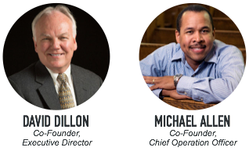
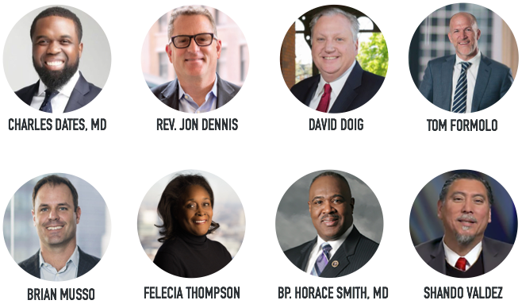
Leadership
EXECUTIVE BOARD

